Slide 1
Online Role-based training resources: Microsoft Learn https://docs.microsoft.com/en-us/learn/

Slide 2
Module 10: Create and Manage Workspaces

Slide 3
Learning Objectives
You will learn the following concepts:
Workspaces
Sharing and Managing Power BI Assets
Notes:
By the end of this module, you’ll be able to:
Create, manage and secure workspace in Power BI
Share and manage Power BI assets

Slide 4
Lesson 1: Creating Workspaces

Slide 5
Introduction to Workspaces
A centralized repository to:
Collaborate with colleagues and teams.
Create collections of reports and dashboards.
Workspaces provide the following benefits:
Share and present reports in a single environment.
Enable the highest level of security.
An environment for housing reports and dashboards for use by others.
Notes:
Through the past few discussions, you've had the chance to do a myriad of tasks, loading and transforming data from a number of sources, building visuals, creating DAX equations, maybe even publishing a report or two to Power BI Service, but what's next? The next step on our data analysis journey is to share these reports with our wider audiences and organizations. We can do this in a workspace, a feature of Power BI Service. A workspace is a centralized repository in which you can collaborate with colleagues and teams to create collections of reports and dashboards.
Workspaces offer the following benefits:
Allow you to share and present reports and dashboards in a single environment.
Ensure that the highest level of security is maintained by controlling who can access datasets, reports, and dashboards.
Focus collaboration efforts as workspaces can be used to house reports and dashboards for use by multiple teams.

Slide 6
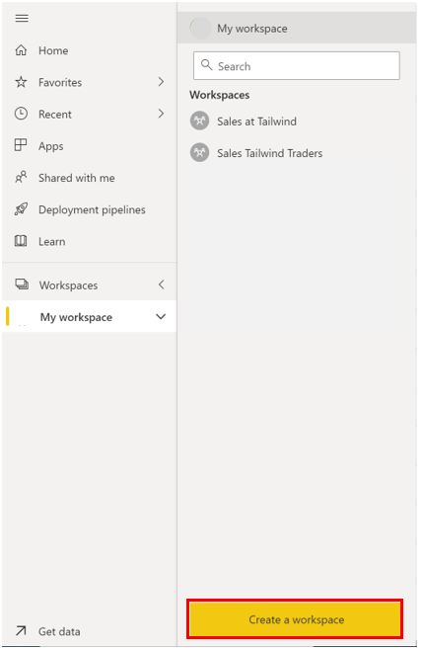
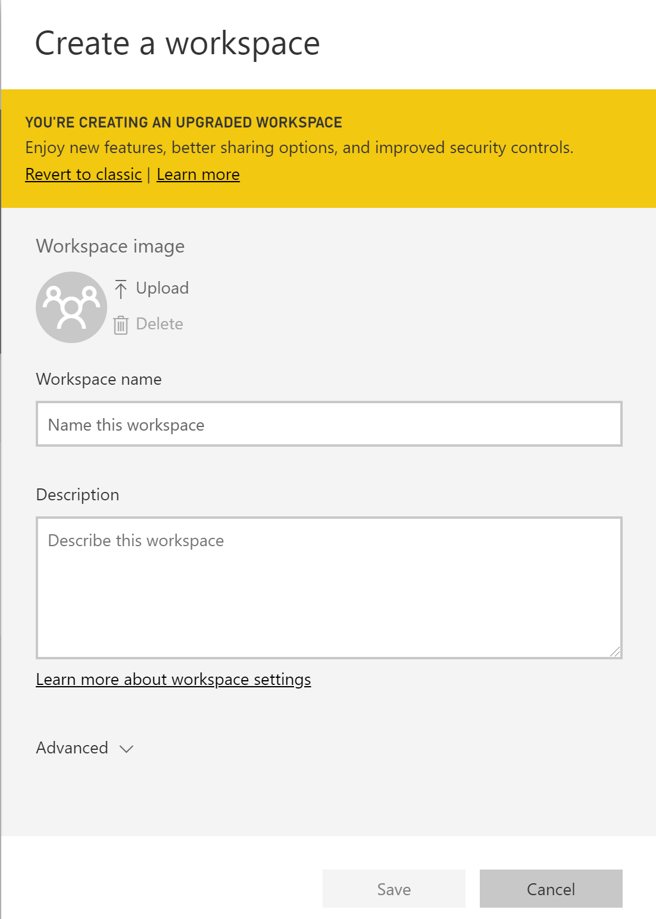
Create a Workspace
Make reports easily viewable and sharable.
Notes:
Create a workspace
Navigate to the Power BI service. Select the dropdown on Workspaces. On the bottom of the resulting panel, you will see a Create New Workspace button.
<CLICK>
Upon selecting Create a Workspace, you are brought to the following window, where you can add in a Workspace name, Description, and Image.
Upon filling out the pertinent fields on this window, select Save and you've created a workspace!
<CLICK>

Slide 7
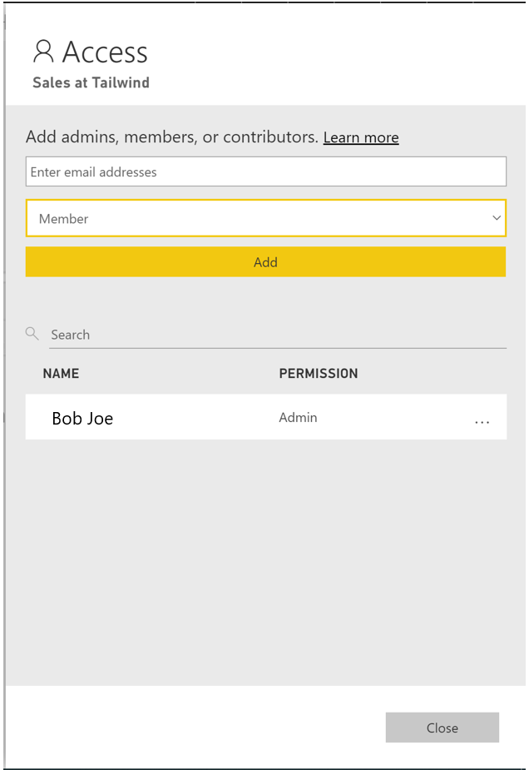
Assign Workspace Roles
Roles determine what a user can do in a workspace, so teams can collaborate.
Key roles include:
Admin.
Member.
Contributor.
Viewer.
Notes:
As the workspace owner, you want to ensure that the appropriate access is given to the members of the Products team since their team includes stakeholders and developers. Workspace roles allow you to designate who can do what within a workspace.
To assign these roles to users, navigate to the workspace you've created and, on the top left of the ribbon, select Access.
Admin:
Add/remove users
Publish, update, share and app in a workspace
Created, edit, delete, and publish reports and content
View and interact with reports and dashboards
Configure data refreshes
Member
All admin tasks EXCEPT remove users
Cannot delete workspaces
Cannot update the metadata about the workspace
Contributor
Cannot add/remove users
Cannot publish, update, edit an app unless given ability by admin
Can create, update, publish content and reports
Can schedule data refreshes
Viewer
Cannot add/remove users
Can only view a report or dashboard
Can read data stored in dataflows

Slide 8
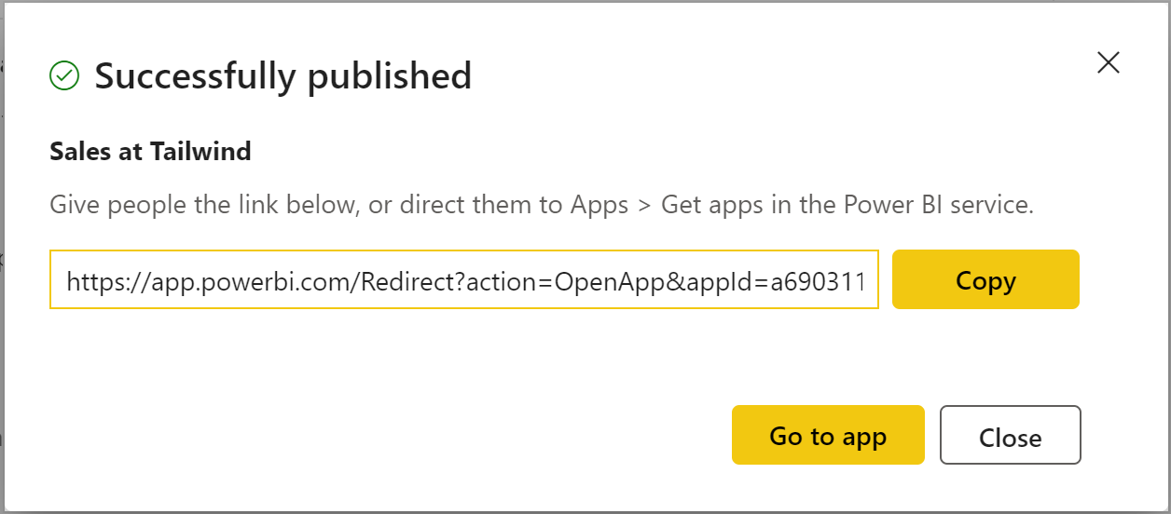

Create Apps
Notes:
Now that you have created an app workspace and assigned your collaborators-specific roles, you want to be able to add content to your app workspace.
An app is a Power BI content type that combines related dashboards and reports, all in one place. An app can have one or more dashboards and one or more reports, all bundled together. Apps are created by Power BI designers who distribute and share the apps with consumers like you. Your apps are organized in the Apps content list.
Content can be in the form of reports, dashboards, datasets, dataflows, etc. An app is a published read-only window into your data for mass distribution and viewing. When you are ready to share apps with your users, you can publish the app. This process requires a Power BI Pro license. Consuming and viewing an app requires a pro license or backed premium capacity.
<CLICK>
When you are ready to publish your app with its collection of reports, dashboards, and datasets, navigate back to the workspace, and select Create App in the top-right corner of the ribbon.
In the Build your app dialog:
Setup tab: Give the app a name, adding a description, and adding an app logo or theme color, if needed. You can change the order in which the
Navigation tab: Select the content to include and the order in which the content is oriented for the user.
Permission tab: grant access either to all the users in your organization or you can choose which users have access.
<CLICK>
Upon making edits were necessary, you can select Publish App and voila you've published an app! You will get the following screen with a link that you can share with your users:

Slide 9

Configure and Update a Workspace App
How do you update a published App?
Navigate back to the workspace.
Make any necessary updates.
Click Update App (previously called Publish App).
Notes:
After publishing your app, you realize that you would like to make updates within your workspace. How can you do this?
Navigate back to the workspace, and make any updates required in the reports or dashboards. The workspace acts as a staging area you can make any changes but they will not be added to the app until you select Update App in the top-right corner of the ribbon (where previously we had Publish App). Dataset and dataflow updates are updated immediately. When you select this, you can make any changes to the Setup, Navigation, and Permissions tab, and when ready, select the Update App button.

Slide 10
Review Questions
1
Q – How is the admin workspace different from other types of workspace roles?
A – Admins are the only role that can remove users.
2
Q – What is the best description of a workspace?
A – A workspace is a centralized location or repository that allows you to collaborate with colleagues and teams to create collections of reports, dashboards, etc.

Slide 11
Lesson 2: Sharing and Managing Assets

Slide 12
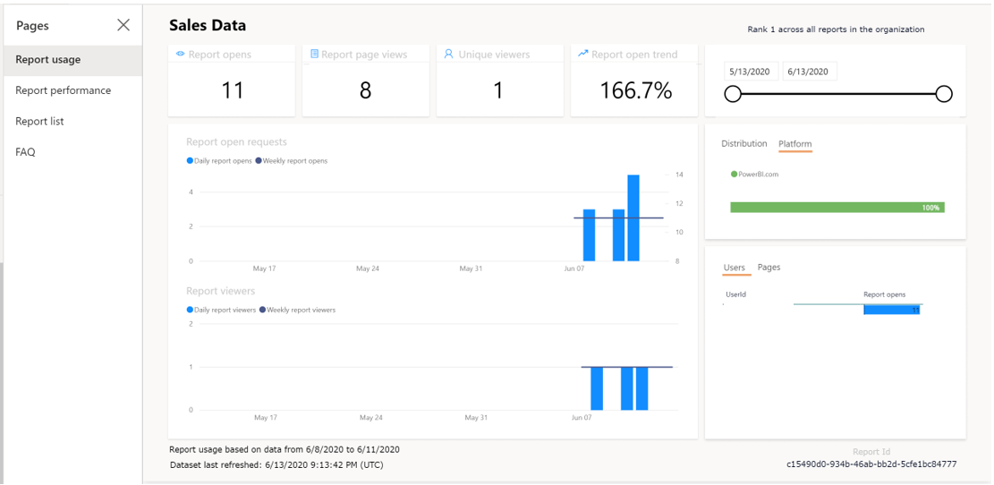
Monitor Usage and Performance
Notes:
Knowing how your workspace is being used and is performing is crucial for several reasons:
Focuses your efforts for improvement; if you know where you have the least performance you can concentrate your efforts for improvement in those areas.
Quantifies the impact of your reports; by seeing usage metrics you can determine how successful your reports are.
These performance and usage metrics are both a feature available for use in a workspace. You can see who's using your reports, what actions are being done on the reports, and what performance issues exist.
Usage metric reports are available for Power BI pro users and can only be accessed by users with role types admin, member, or contributor.
Navigate to the pertinent workspace. Then, find the report or dashboard you would like to see usage metrics for. Let's say we want to see the usage metrics report for Sales Data. Under the ellipsis, select View usage metrics report.
You can view such details as:
Viewers per day, Unique viewers per day (which doesn't include users who come back to the same reports multiple times), Shares per day charts
Total views, Total Viewers, and Total Shares KPI cards
Total views and shares Ranking: Compares how your report is doing in comparison to other reports in the app
Views by Users: detail about each specific user that viewed the dashboard.
You can also filter by the distribution method of the report (for example, through sharing or from the workspace directly) and platform type (for example, mobile or web).
<Click>
You can also view performance metrics on the next tab, Report performance, including:
Typical opening time: how long it takes, at the 50th percentile, to open the report.
Opening time trend: how the typical opening time changes over time. This can tell you how the report is performing as the number of users starts to grow.
Daily/7-Day Performance charts: highlights the performance for 10%, 50, and 90% of the open-report actions every day and over a seven-day period.
Filters for date, so you can see how the performance changes according to the day.

Slide 13
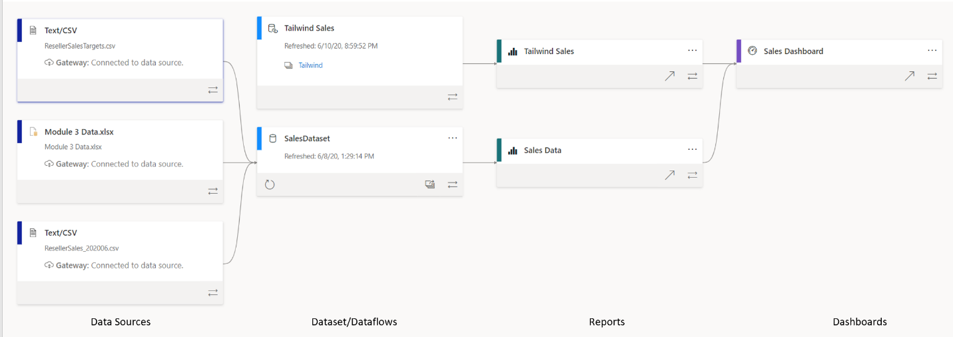
Viewing Data Lineage
Notes:
You've had the chance to develop many reports and have published them to the Tailwind workspace. However, because you are also collaborating with the Products team, it has become increasingly difficult to track which reports need to be refreshed and even which datasets are in which report, it is a jumbled mess! You want to be able to determine which datasets need to be refreshed as you've been getting reports of stale data. The path of data from its source to the destination can often be a gargantuan challenge, and more so if you have multiple datasets to add to the mix. How can you make sense of the intricacies of the data paths and troubleshoot unrefreshed data?
Power BI's Lineage View allows you to do just that. In Lineage View, you can quickly refresh datasets and see the relationships between the artifacts in a workspace as well as their external dependencies.
Data lineage refers to the path that data takes from the data source to the destination. View lineage in Power BI is crucial for several reasons:
Simplifies the troubleshooting process, as you can see the path the data takes from source to destination and easily determine pain points and bottlenecks.
Allows you to manage your workspaces more easily and clearly see the impact of a single change in one dataset to reports and dashboards.
Saves time by making it easy to identify reports and dashboards that haven't been refreshed.
Lineage concepts:
Lineage view: Only accessible to admin, contributor, and member roles, the view shows us all the artifacts in our workspace. Artifacts include data sources, datasets and dataflows, reports, and dashboards. Each card represents an artifact, and the arrows in between these cards represent the flow of data, or the relationship between different artifacts.
Data sources: This card tells you the type of data source (for example, Text/CSV) and the gateway.
Gateway: Gateway tells us the source of our data.
Datasets/dataflows: On these cards you can see when the dataset was last refreshed, , if the dataset or dataflow is certified or promoted, as well refresh the dataset itself by selecting the arrow icon on the bottom left of the card.
Report / Dashboards: Similar functionality as the data source and dataset cards. Selecting a card will bring up a window in which you can view the metadata about the report or dashboard; here, you can also go directly to the report or dashboard. You can also enable or disable whether you would like to include this report or dashboard within the app.
The lineage view is a powerful troubleshooting feature that makes it a quick and painless task to see the path the data takes from source to destination and easily determine pain points and bottlenecks.

Slide 14
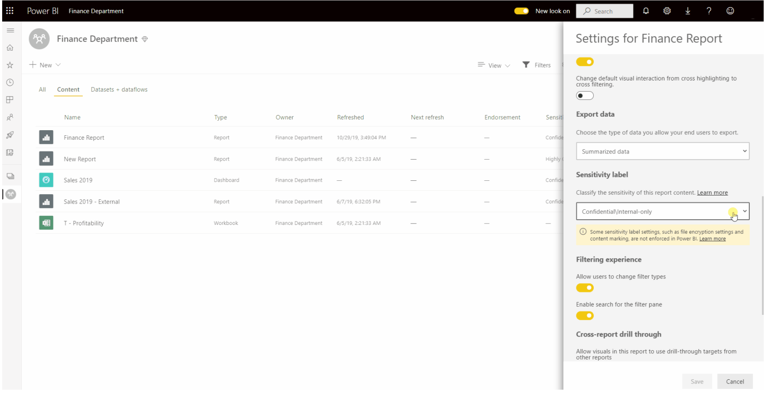
Data Protection
Classify and label sensitive Power BI data
Enforce governance policies even when Power BI content is exported
Monitor and protect user activity on sensitive data in real time
Empower security administrators
Notes:
Microsoft Information Protection sensitivity labels provide a simple way for your users to classify critical content in Power BI without compromising productivity or the ability to collaborate. Sensitivity labels can be applied on datasets, reports, dashboards, and dataflows. When data is exported from Power BI to Excel, PowerPoint or PDF files, Power BI automatically applies a sensitivity label on the exported file and protects it according to the label’s file encryption settings. This way your sensitive data remains protected no matter where it is.
Power BI provides end-to-end label consistency including:
Label inheritance upon creation of new content: When new reports and dashboards are created in the Power BI service, they will automatically inherit the sensitivity label previously applied on parent dataset or report. For example, a new report created on top of a dataset that has a “Highly Confidential” sensitivity label will automatically receive the “Highly Confidential” label as well.
Sensitivity labels persist when a Power BI report is embedded in an app: Power BI business reports are often embedded in business applications such as Microsoft Teams, SharePoint, or an organization’s website. Now when you embed sensitive information, the label applied on your reports and dashboards will be visible in the embedded view and persist when data is exported to Excel.
Sensitivity label inheritance from Power BI to Excel for live data connections: When you create PivotTable in Excel with live connection to Power BI dataset (“Analyze In Excel”), that dataset’s sensitivity label will be inherited and applied to your Excel file along with its associated protection.
With Power BI's data protection capabilities you can:
Classify and label sensitive Power BI data using Microsoft Information Protection sensitivity labels used in Office and other Microsoft products.
Enforce governance policies even when Power BI content is exported to Excel, PowerPoint, PDF, and other supported export formats to help ensure data is protected even when it leaves Power BI.
Monitor and protect user activity on sensitive data in real time with alerts, session monitoring, and risk remediation using Cloud App Security.
Empower security administrators who use data protection reports and security investigation capabilities with Microsoft Cloud App Security to enhance organizational oversight.

Slide 15
Review Questions
1
Q – What feature in Power BI service can you use to troubleshoot the flow of data from its source to destination?
A – View Lineage
2
Q – A key tenet of data protection is sensitivity labels, which specifies what?
A – Which data can be exported.

Slide 16
Module Overview
We covered the following concepts:
Workspaces
Sharing and Managing Power BI Assets
Notes:
In this module we discussed:
How to create, manage and secure workspace in Power BI.
How to share and manage Power BI assets.

Slide 17

References
PL-300 Create and manage Workspaces in Power BI
https://docs.microsoft.com/en-us/learn/modules/create-manage-workspaces-power-bi/
Notes:
It is good practice to tie back your ILT deliveries to role-based learning materials on Microsoft Learn. What is listed here should supplement your delivery and the role-based training your course is affiliated with. It is important to give the learners continued education opportunities for growth.
Steps:
Insert the page title here along with the url to other Microsoft resources
It is only necessary to duplicate this slide if there are more than 6 references that need to be shared with the students.

Slide 18
Closing slide

